Slide 1
Rotary Vision
Together, we see a world where people unite and take action to create lasting change – across the globe, in our communities, and in ourselves.

Slide 2
Jennifer Jones makes history

Slide 3
Jennifer Jones Stampede Parade 2022 Cheering Squad

Slide 4
Days For Girls Founder Celeste Mergens And Women in Rotary

Slide 5
Days For Girls and the best Rotary Volunteers

Slide 6
Days For Girls Sew In

Slide 7
Girl Guides Sew In

Slide 8
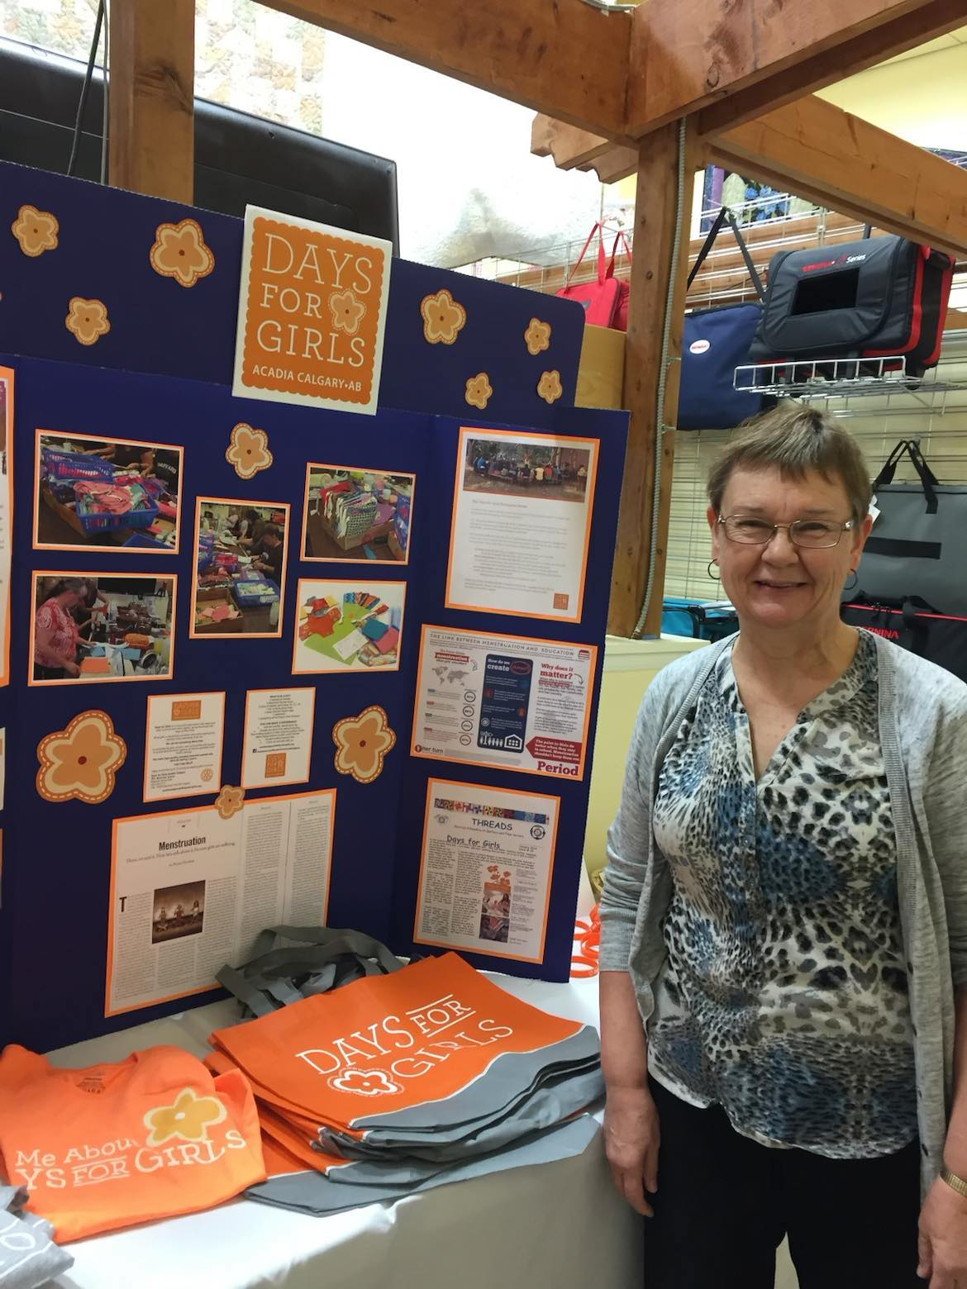

Slide 9
Days For Girls Shipment to Dominican Republic 2023

Slide 10
Dominican Republic Power Team

Slide 11
Dominican Republic Days For Girls Advocates

Slide 12
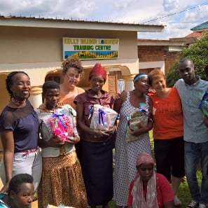
Teaching - Days For Girls in Rwanda

Slide 13
Days for Girls
Nepal
Elsie James
DFG Enterprise

Slide 14
Rotary in the hills of Nepal The Nepali DFG Team

Slide 15
Rotary International Convention And Days For Girls Hamburg Germany 2019

Slide 16
RI Germany Mystery Tour

Slide 17
DG Dan Doherty Rotary International Hawaii Convention

Slide 18
Mentoring gave me Syrian GrandKids

Slide 20
Providing Support to the Newcomers Center Sewing Machine, anyone?

Slide 21
Rotary Friendship Exchange 2019

Slide 22
Women in Rotary Speaker Panel Why I love Rotary

Slide 25
Right here at home,
we have to find solutions and provide education for the girls

Slide 26
Atlanta Georgia 2017 RI Convention

Slide 27
Quilts From The Heart 3000 Quilts and counting

Slide 29
Luna Centre aka Sheldon Kennedy Center

Slide 30
2013 Floods Canmore Calgary HighRiver

Slide 31
THE FOUR-WAY TEST
Is is the truth?
Is it fair to all concerned?
Will it build goodwill and better friendships?
Will it be beneficial to all concerned?

Slide 32
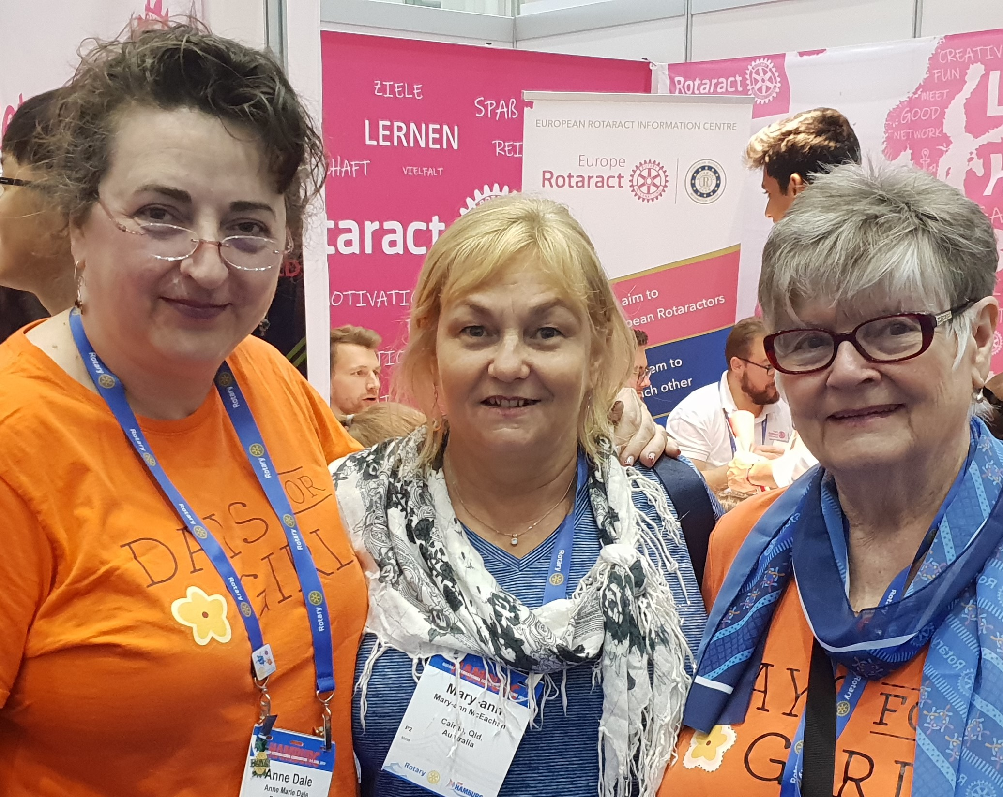
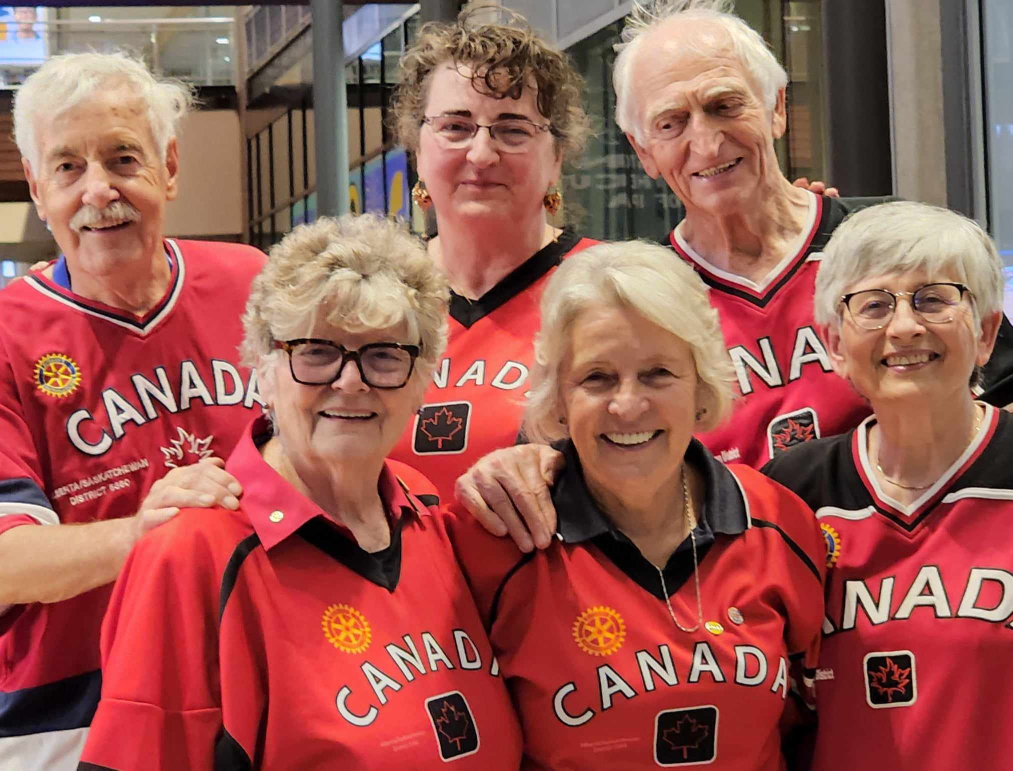
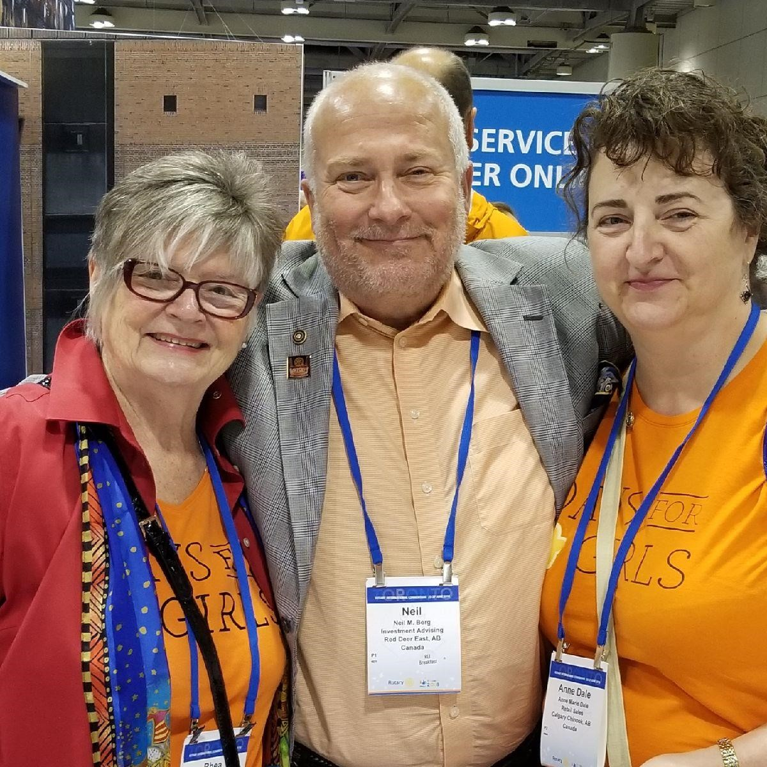
Around the world with Rotary we have friends we have yet to meet, but many are right here!

Slide 33
Thank you for your kind attention,
for being here today,
I appreciate you.

